Slide 1

DEPARTMENT OF ARTIFICIAL INTELLIGENCE AND DATA SCIENCE ACADEMIC YEAR 2025 - 2026 SEMESTER III ARTIFICIAL INTELLIGENCE LABORATORY MINI PROJECT REVIEW GOLD PRICE PREDICTION USING LINEAR REGRESSION
REGISTER NUMBER | 2117240070049
NAME | DEEPAK G
YEAR | ll
SECTION | A
FACULTY IN-CHARGE | Mrs. M. Divya

Slide 2
PROBLEM STATEMENT
Gold is one of the most valuable commodities and widely used as an investment asset. Predicting gold prices is important for investors and financial analysts.
Machine Learning helps analyze historical data and predict future trends.
In this project, Linear Regression is used to predict gold prices using:
Historical price data
Lag features
Rolling statistics
Linear Regression is a supervised learning algorithm used for predicting continuous values.
Machine Learning provides a data-driven approach for better forecasting accuracy.
Feature engineering (lag values, rolling averages) helps capture hidden patterns in time-series data.
Predicting gold prices can help in investment planning and risk management.

Slide 3
IMPLEMENTATION AND CODE
Link to code in Git-hub Repository
List | Git-hub Repository Links
Implementation of Code Link | github.com/DeepakG77/Gold-price-prediction
Word Document Report Link | word report
PPT Link | MLLAB_MINI_PPT_TEMPLATE_AI^L0DS.pptx

Slide 4
THEORETICAL BACKGROUND
The project uses Machine Learning (Supervised Learning) for regression.
Linear Regression:
Models relationship between input features and output
Predicts continuous values (gold price)
Key Concepts:
Least Squares Method (error minimization)
Feature Engineering:
Lag values
Rolling averages
Volatility
Why Linear Regression?
Simple and interpretable
Efficient
High accuracy achieved (R² ≈ 0.95)

Slide 5
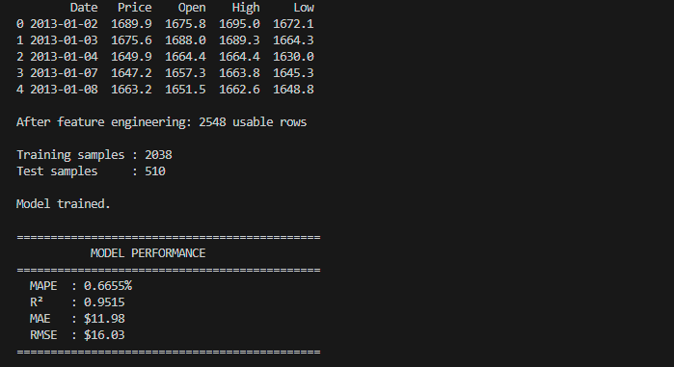
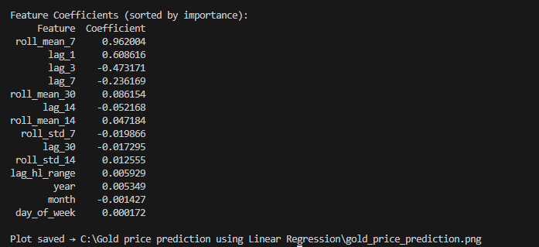
OUTPUT AND RESULTS
Model Performance:
MAPE: ~0.67%
R² Score: ~0.95
MAE: ~$12
RMSE: ~$16
Observations:
Very low error → high accuracy
Model explains ~95% variance
Predictions closely match actual values
Key Features:
roll_mean_7
lag_1
lag_3
lag_7

Slide 6
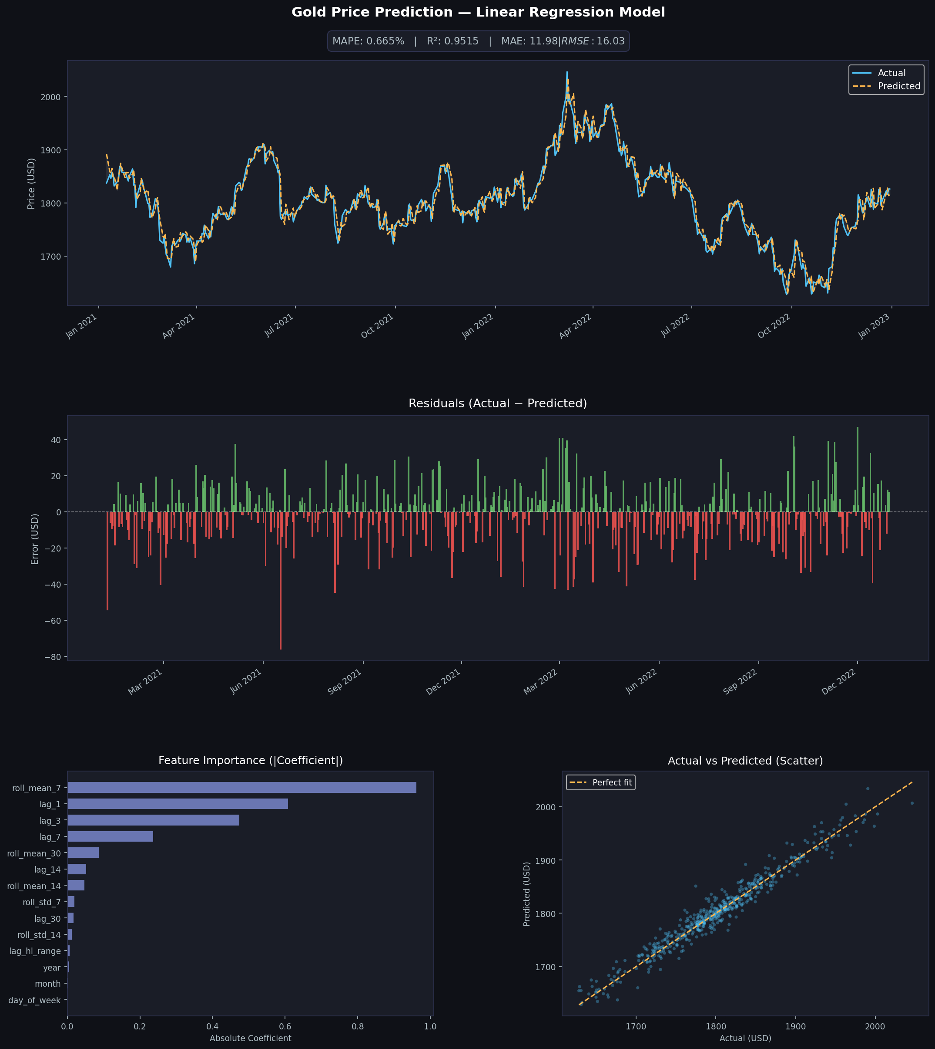
OUTPUT AND RESULTS
Visualizations:
Actual vs Predicted graph
Residual plot
Feature importance chart
Scatter plot
Interpretation:
Strong model performance
Minimal bias
Good generalization
Future Enhancements:
Use LSTM for better prediction
Include external factors:
Inflation
USD index
Oil prices
Real-time prediction system

Slide 7
REFERENCES
•Python Software Foundation, Python Documentation. Available at: https://docs.python.org/
•Pandas Development Team, Pandas Documentation. Available at: https://pandas.pydata.org/docs/
•Matplotlib Developers, Matplotlib Documentation. Available at: https://matplotlib.org/stable/contents.html
•Seaborn Developers, Seaborn Documentation. Available at: https://seaborn.pydata.org/
•Kaggle, Gold price Dataset. Available at: https://www.kaggle.com/
•NumPy Developers, NumPy Documentation. Available at: https://numpy.org/doc/

